Slide 1


VECTOR MECHANICS FOR ENGINEERS
By: Fardinand P. Beer; E. Russell Johnston, Jr.; David F. Mazurek
ENGINEERING 3120
STATICS
CHAPTER 1
INTRODUCTION
Slides revised by:
A.A. KHANDKER, Ph.D., P.E.
Copyright: McGraw Hill Education

Slide 2
TOPICS IN CHAPTER 1
What is Statics?
What is Mechanics?
Fundamental Concepts and Principles
Systems of Units
Conversion from One System of Units to Another Method of Problem Solution
Numerical Accuracy

Slide 3

WHAT IS STATICS?
Statics is the study of methods for quantifying the forces between rigid bodies and within structure members.
Forces are responsible for causing motion of bodies, maintaining balance and changing configuration or shape.

Slide 4

APPLICATION OF FORCES
We encounter a great number and variety of applications of forces every day, such as when we press a button or keyboard, turn a doorknob and open a door, and carry a bag or book.

Slide 5
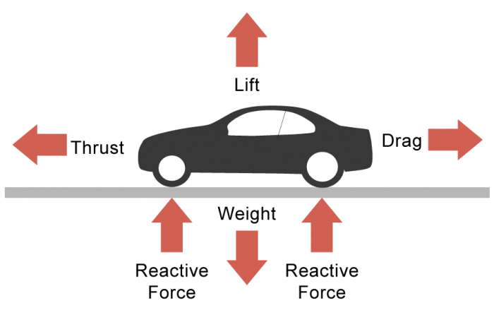
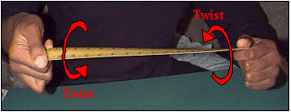
APPLICATION OF FORCES
Motion and changes in configuration are critical to the functionality of man-made objects as well as objects the nature.

Slide 6

OBJECTIVE OF BASIC STATICS COURSE
Objective of this basic statics course is to provide the engineering students the ability to analyze a problem in a simple and logical manner and to apply a few basic principles of statics to its solution

Slide 7

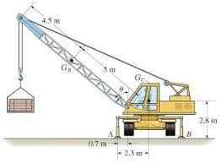
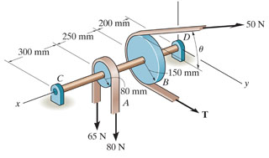
HOW DOES STATICS FIT INTO UPPER LEVEL COURSES?
Statics is an essential prerequisite for many branches of engineering, such as mechanical, civil, automobile, aeronautical, and bioengineering, which address the applications and consequences of various forces applied to particles and rigid bodies.

Slide 8
WHAT IS MECHANICS
Mechanics is the study of bodies under the action of forces.
Mechanics may be considered as applied statics, closely related to physics, so that many of the concepts will build on that prior scientific knowledge.
Mechanics is the foundation of many engineering disciplines and is an indispensable prerequisite to their study.

Slide 9
CATEGORIES OF MECHANICS
Rigid bodies (Solids)
Statics – bodies at rest or at constant velocity Dynamics – accelerating bodies
(without changing shape)
Deformable bodies (Elastic or Plastic)
Elastic Bodies – temporary deformation
Plastic Bodies – permanent deformation
Fluids – gas and/or liquid
Non-Compressible fluids
Compressible Fluids

Slide 10
FUNDAMENTAL CONCEPTS
Space - associated with the notion of the position of a point P given in terms of three coordinates measured from a reference point or origin.
Time - definition of an event requires specification of the time and position at which it occurred.
Mass - used to characterize and compare bodies, e.g., response to earth’s gravitational attraction and resistance to changes in translational motion.
Force - represents the action of one body on another. A force is characterized by its point of application, magnitude, and direction, i.e., a force is a vector quantity.

Slide 11
FUNDAMENTAL CONCEPTS
In Newtonian Mechanics, space, time, and mass are absolute concepts, independent of each other.
Force, however, is not independent of the other three.
The force acting on a body is related to the mass of the body and the variation of its velocity with time.
.

Slide 12
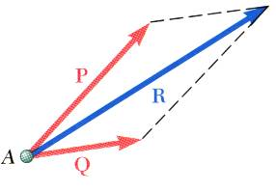
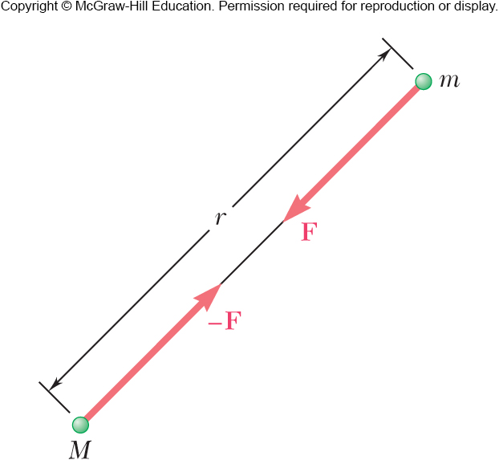
FUNDAMENTAL PRINCIPLES
Parallelogram Law
Equilibrium:
Two forces, P & Q acting on a particle may be replaced by a single Resultant force, R, equal to the diagonal of the parallelogram which has sides equal to P and Q .
Two equal and opposite forces, (F & -F) create the state of equilibrium

Slide 13
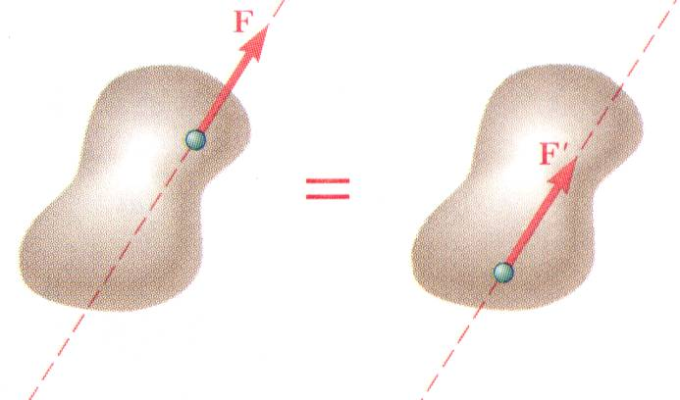
FUNDAMENTAL PRINCIPLES
Principle of Transmissibility
The condition of equilibrium or of motion of a rigid body will remain unchanged if a force F acting at a given point of the rigid body is replaced by a force of same magnitude and same direction acting at a different point provided that the two forces have the same line of action.

Slide 14
NEWTON’S THREE FUNDAMENTAL LAWS
Newton’s First Law: If the resultant force acting on a particle is zero, the particle will remain at rest (if originally at rest) or continue to move in a straight line (if originally in motion).
Newton’s Second Law: If the resultant force acting on a particle is not zero, the particle will have an acceleration proportional to the magnitude of the resultant and in the direction of the resultant.
The law is mathematically stated as:
F = ma
Where, F = the resultant force acting at a known direction
m = the mass of the particle
a = acceleration of the particle in the same direction

Slide 15
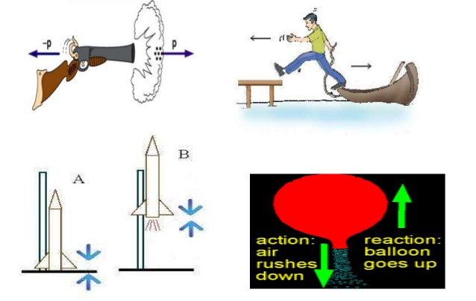
NEWTON’S THREE FUNDAMENTAL LAWS
Newton’s Third Law: The forces of action and reaction between two bodies in contact, have the same magnitude and line of action and opposite sense.

Slide 16
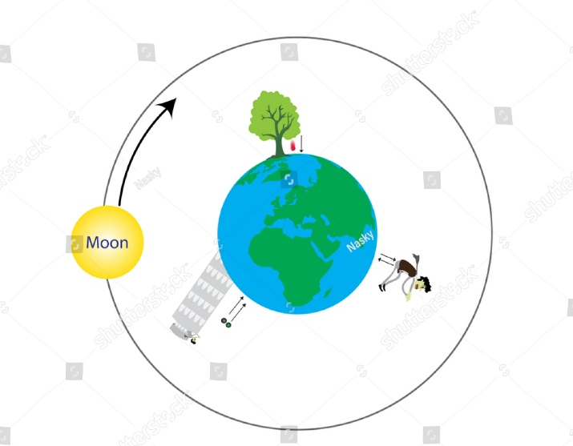
NEWTON’S LAW of GRAVITY
Newton’s Law of Gravitation:
Two particles are attracted with equal and opposite forces.
F = G.M.m/r²
Where, F = Force of Gravity
G = Constant of Gravitation
M, m = mass of the two particles
r = distance between two particles
g = G.M/R²
W = mg
Where, R = Radius of Earth
g = Acceleration due to gravity
W = Weight of the particle with mass m
Earth’s Gravity

Slide 17
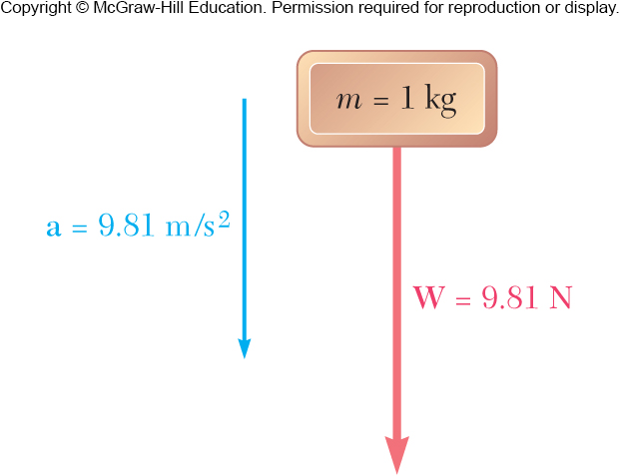
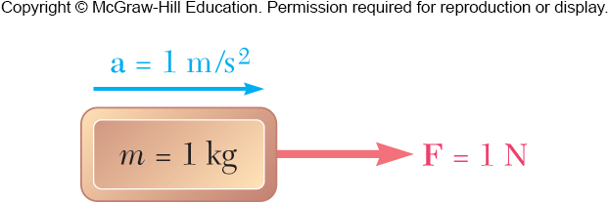
Systems of Units
International System of Units (SI): The basic units are length, time, and mass which are arbitrarily defined as the meter (m), second (s), and kilogram (kg). Force is the derived unit.

Slide 18
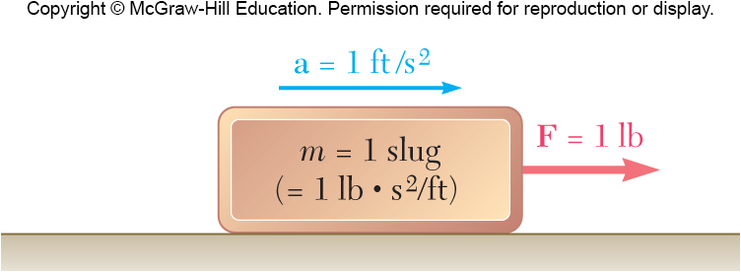
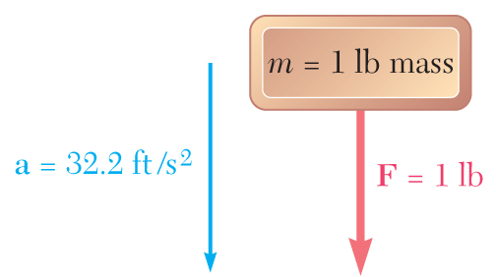
Systems of Units
U.S. Customary Units: The basic units are length, time, and force which are arbitrarily defined as the foot (ft), second (s), and pound (lb). Mass is the derived unit,

Slide 19
Systems of Units
Kinetic Units: Length, Time, Mass, and Force.
The basic kinetic units, length time and mass, may be defined arbitrarily and are independent of each other.
The fourth unit is a derived unit, which must have a definition compatible with Newton’s 2nd Law,

Slide 20
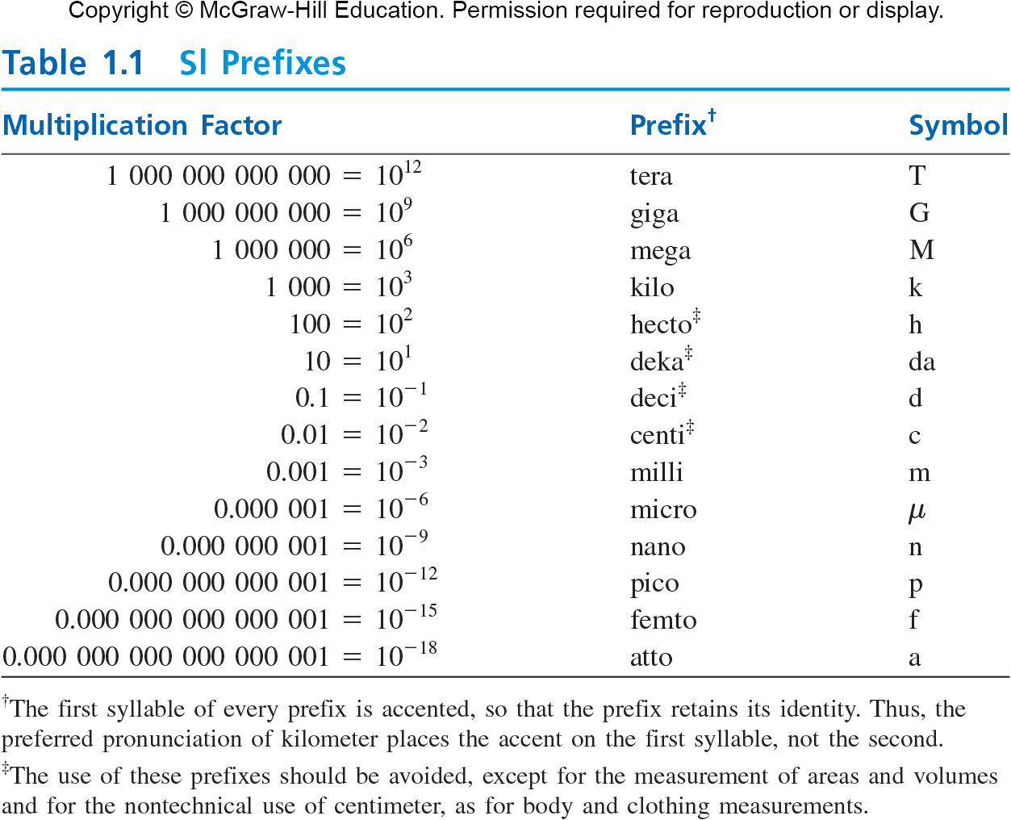

Slide 21
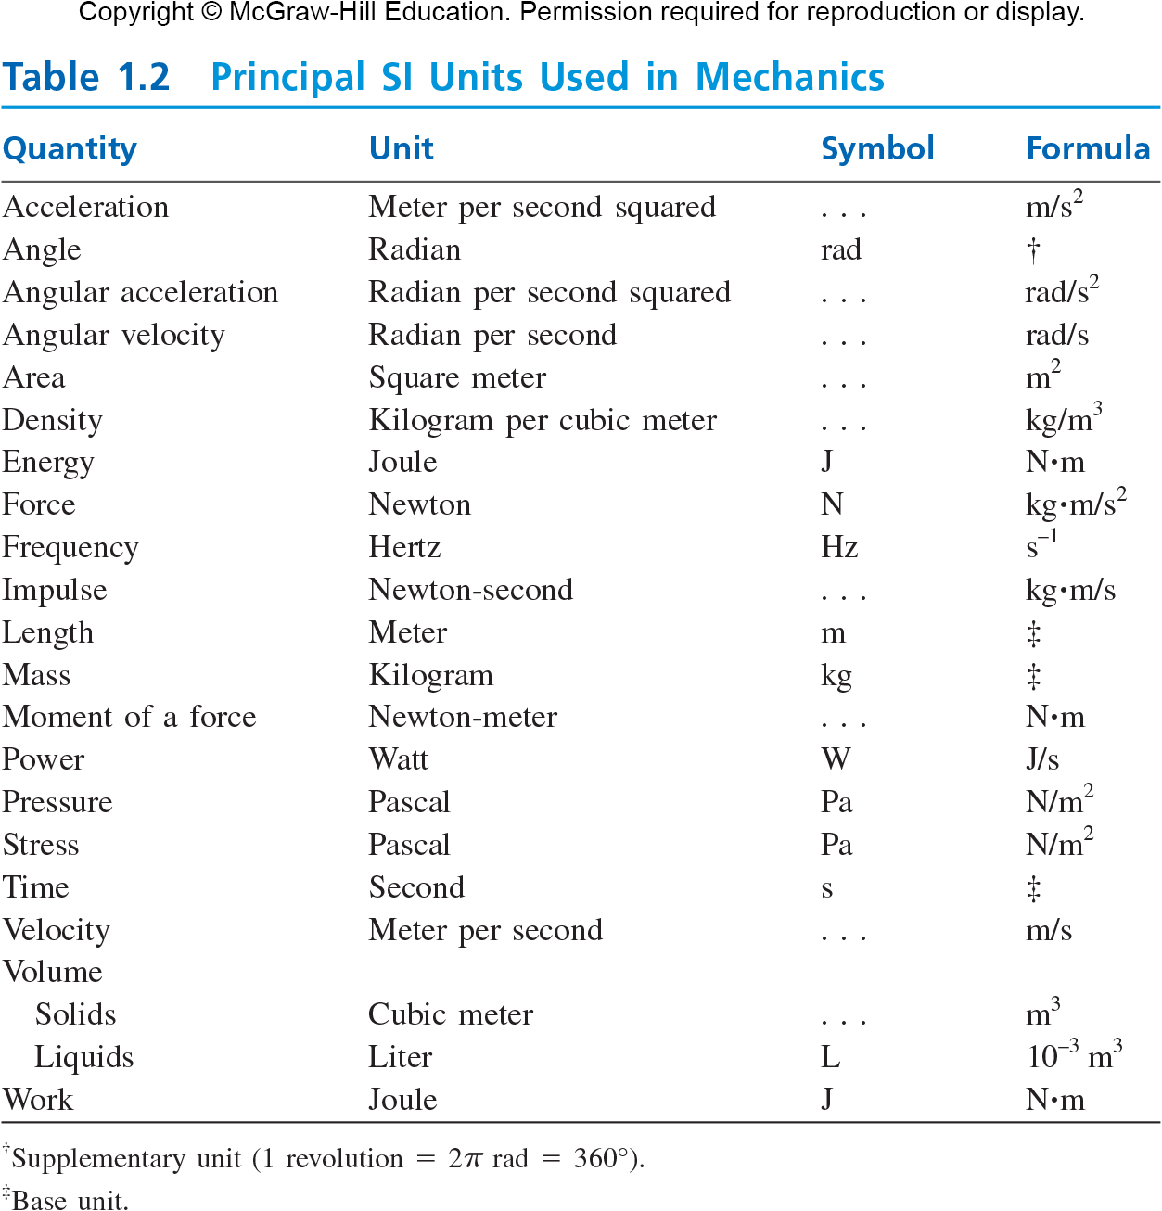

Slide 22
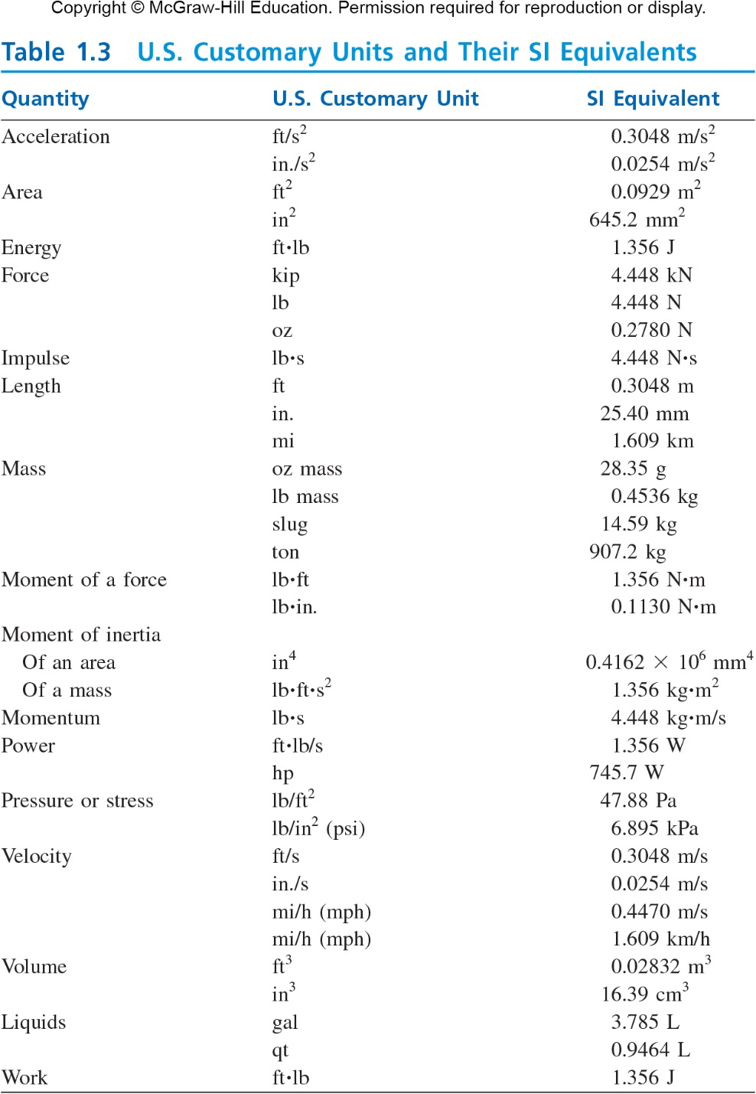

Slide 23
Method of Problem Solution
Problem Statement: Includes given data, specification of what is to be determined, and a figure showing all quantities involved.
Free-Body Diagrams: Create separate diagrams for each of the bodies involved with a clear indication of all forces acting on each body.
Fundamental Principles: The six fundamental principles are applied to express the conditions of rest or motion of each body. The rules of algebra are applied to solve the equations for the unknown quantities.

Slide 24
Method of Problem Solution
Solution Check: - Test for errors in reasoning by verifying that the units of the computed results are correct,
- test for errors in computation by substituting given data and computed results into previously unused equations based on the six principles,
- always apply experience and physical intuition to assess whether results seem “reasonable”.

Slide 25
METHOD OF SOLVING PROBLEMS - SMART METHODOLOGY
Strategy: Includes given data, specification of what is to be determined, and a figure showing all quantities involved. Decide what learned concepts apply.
Reflect and Think:
Reflect the use of given data, sketch and concepts used.
Is there any alternative way of solving the problem?
Test for errors in reasoning by verifying that the units of the computed results are correct,
Test for errors in computation by substituting given data and computed results into previously unused equations based on the six principles,
Always apply experience and physical intuition to assess whether results seem “reasonable”
Modeling: Create separate diagrams for each of the bodies involved with a clear indication of all forces acting on each body.
Analysis: The six fundamental principles are applied to express the conditions of rest or motion of each body. The rules of algebra are applied to solve the equations for the unknown quantities.

Slide 26
Numerical Accuracy
The accuracy of a solution depends on
accuracy of the given data, and
2) accuracy of the computations performed.
The solution cannot be more accurate than the less accurate of these two.
The use of hand calculators and computers generally makes the accuracy of the computations much greater than the accuracy of the data. Hence, the solution accuracy is usually limited by the data accuracy.
Use computer programs to solve a problem and use it for repeat or similar problems with different data.

Slide 27
Numerical Accuracy
For engineering problems, the data are seldom known with an accuracy greater than 0.2%. Therefore, it is usually appropriate to record
- Parameters beginning with “1” with four digits such as 15.58 lb; 155.8 lb; 1558 lb
- And with three digits in all other cases, such as 4.02 lb; 40.2 lb; 402 lb
Some engineers use three decimal points for data and analysis and two decimal points for results. May vary for different branches of engineering.

Slide 28

Please submit your questions in writing
with your name at the top of the page
I will discuss the answers in the following class for every one’s benefit.
END OF CHAPTER 1

